Slide 1
Spotify Music Analysis and Genre Classification
Michael Salgado

Slide 2
Introduction
User analytics
Recommendation systems
Use audio features to predict music genres?
Notes:
Obtaining user analytics to create personalized product
Amazon products
Netflix shows
Improve recommendation systems
Can we use auto generated audio features to find more correlations between songs on Spotify

Slide 3
Background
https://www.kaggle.com/vicsuperman/prediction-of-music-genre
17 feature columns
50,000 rows
[‘instance_id’, ‘artist_name’, ‘track_name’, 'popularity', 'acousticness', 'danceability', 'duration_ms', 'energy', 'instrumentalness’, 'key', 'liveness', 'loudness', 'mode', 'speechiness', 'tempo’, ‘obtained_date’, 'valence', 'music_genre’]
Notes:
Obtained using Spotify’s Web API
Algorithms not publicly available
the "energy" feature is a floating point number from 0.0 to 1.0 and represents "a perceptual measure of intensity and activity...perceptual features contributing to this attribute include dynamic range, perceived loudness, tone, onset rate, and general entropy."

Slide 4
Procedure
Using Python, Pandas, matplotlib, sklearn
Data Preprocessing
Data visual correlations
Classification Predictions (Decision tree and kNN)

Slide 5

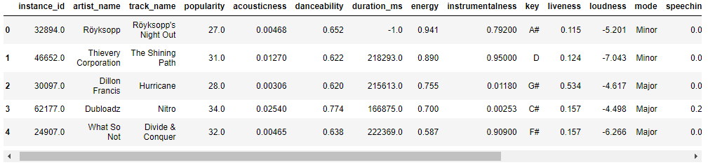
Data Preprocessing Loading in the Dataset

Slide 6
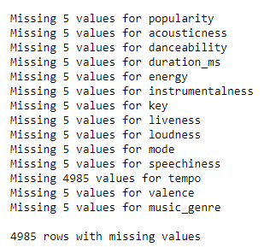
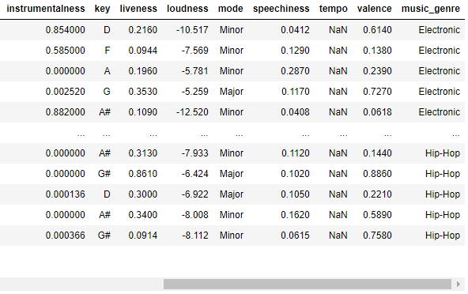
Data Preprocessing Dropping data
Dropping instance_id, obtained_date, artist_name, track_name
Notes:
Converting types to correct data types

Slide 7
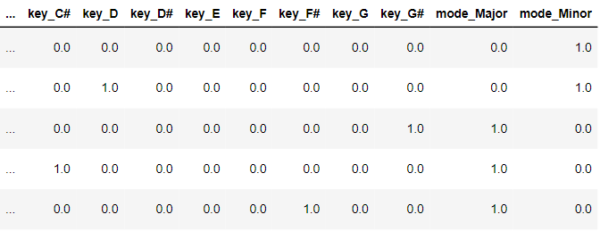
Data Preprocessing Encoding categorical variables
Notes:
Key and mode are nominal data

Slide 8
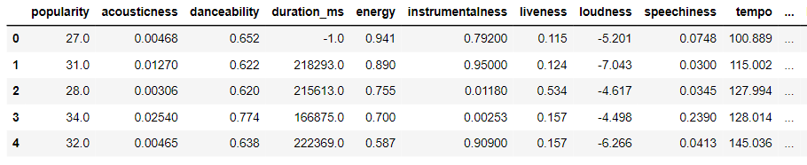
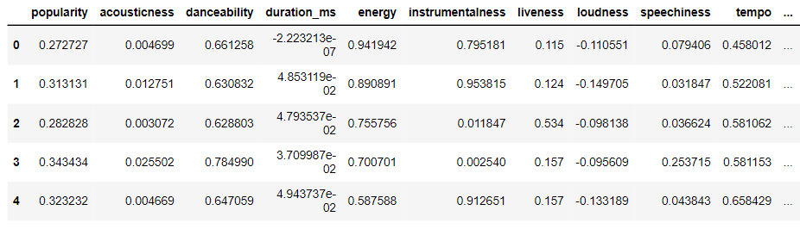
Data Preprocessing Data normalization
Notes:
Normalization helps with improving performance and training stability for models

Slide 9
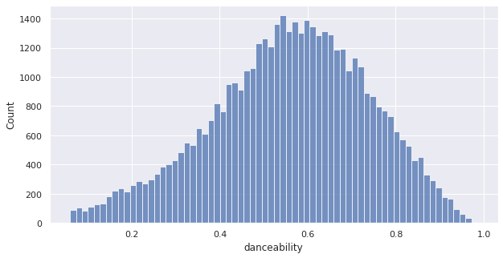
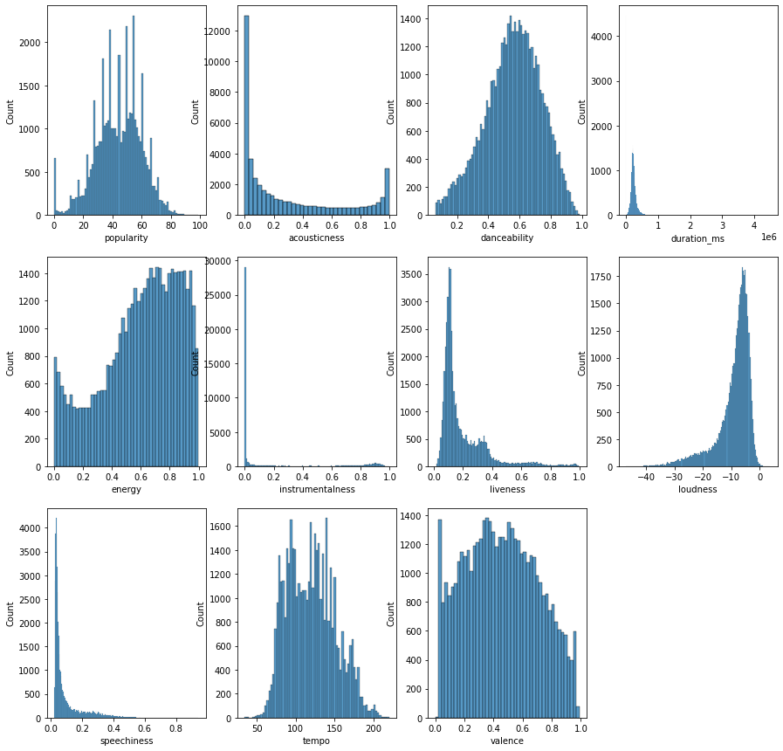
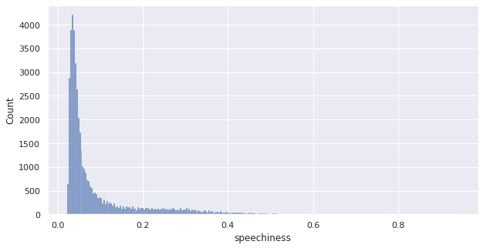
Data Visualization Numerical variable counts
Notes:
Explain why these plots
Normal distribution (danceability)
Not normal distribution (speechieness)

Slide 10
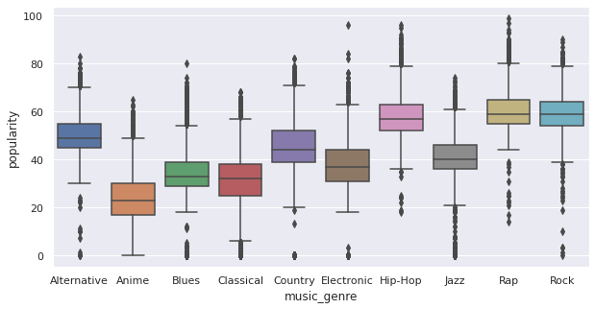
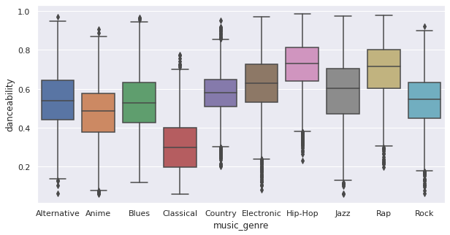
Data Visualization Numerical correlations
Notes:
Explanation of possible correlations in box plot

Slide 11
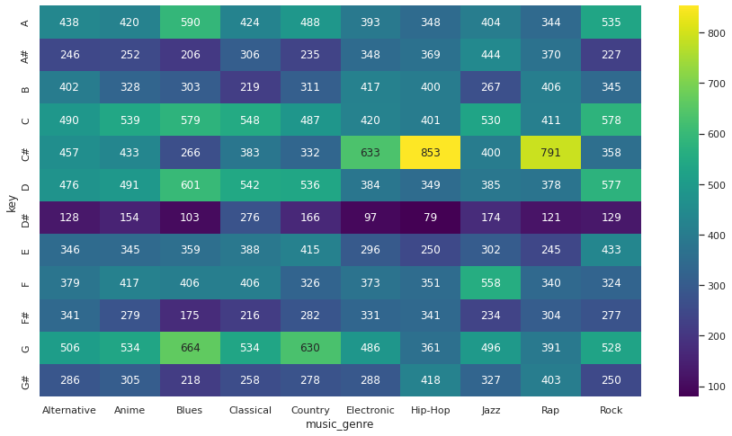
Data Visualization Key vs. Genre
Notes:
Explain heatmap plot

Slide 12
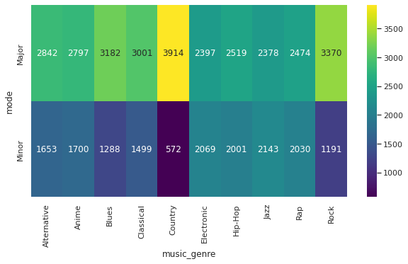
Data Visualization Mode vs. Genre

Slide 13

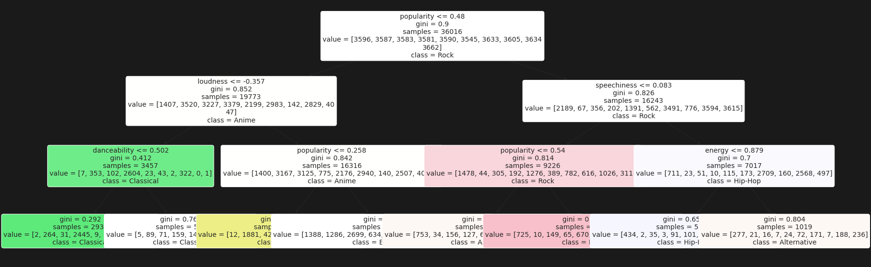
Classification Decision Tree
Notes:
Train/test split of 80/20
Simple way of structuring a model
High interpretability

Slide 14
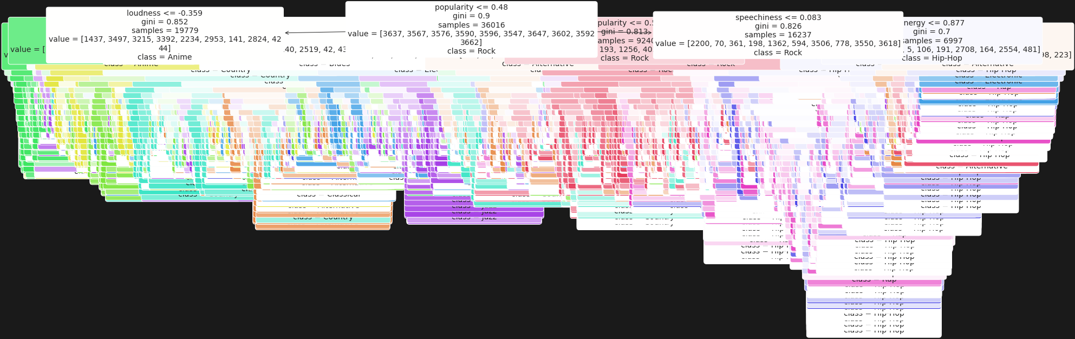

Slide 15
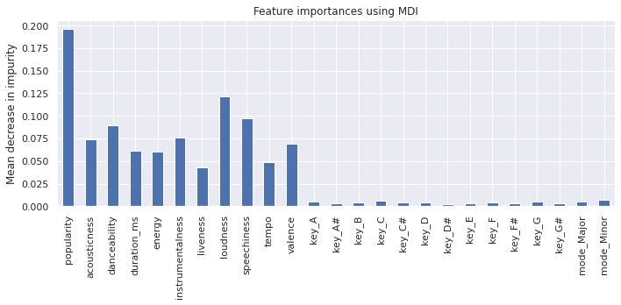
Classification Decision Tree Variable Importance

Slide 16
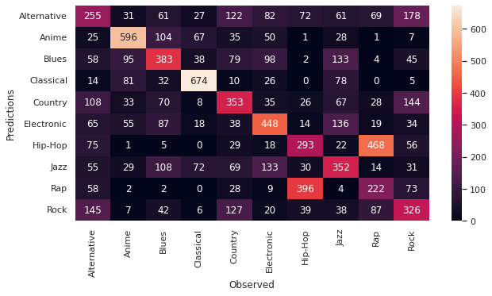
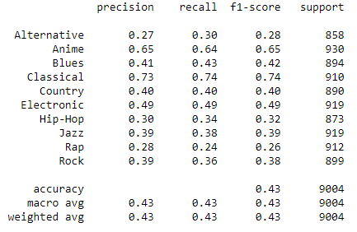
Classification Decision Tree Results
Notes:
Can’t use RMSE or MAE
#### Metrics
**Accuracy**: Overall measure, correctly predicted observations over total observations.
**Precision**: Correctly predicted true observations over total predicted true observations. Good for scenarios where false positives are bad (email spam detection).
**Recall**: Correctly predicted true observations over total observations in a class. Good for scenarios where false negatives are bad (fraud detection).
**F1-score**: Weighted average of precision and recall. F1 is a good mesaure of there is an uneven class distribution (Functional vs defective devices manufactured) and needs a balance between precision and recall.
accuracy:0.37

Slide 17
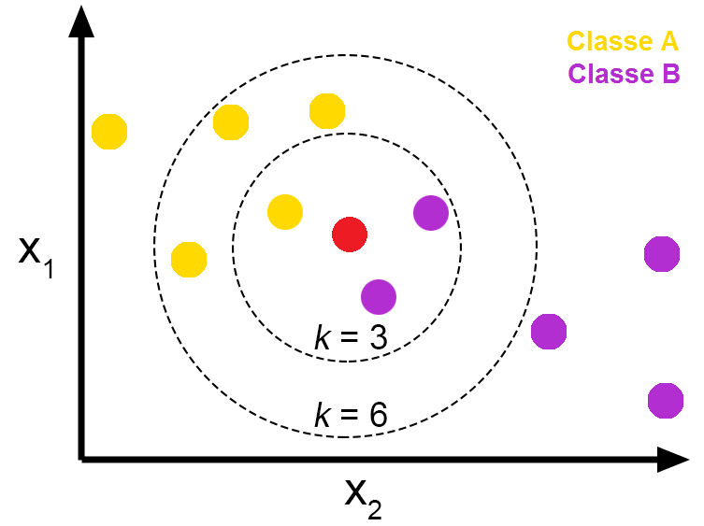


Classification kNN Algorithm
Notes:
Classifies data based on a data points distance from another.
If we have a dataset of bananas and tomatoes, data such as color and shape will be grouped up together
kNN does not provide a prediction for variable importance

Slide 18
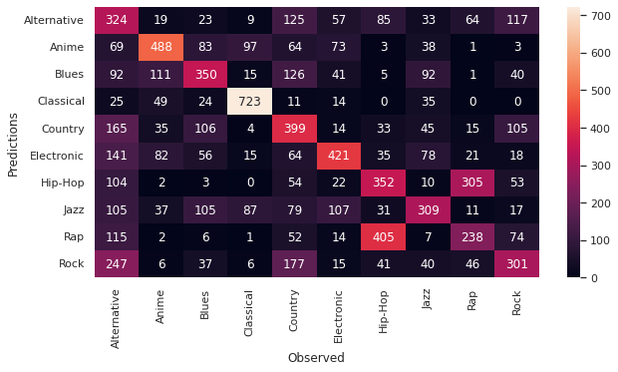
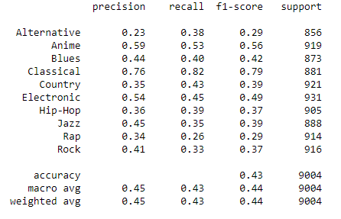
Classification kNN Results

Slide 19
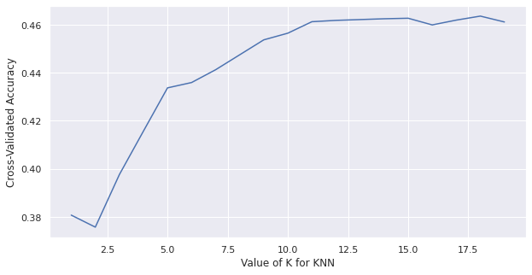
Classification Finding optimal k-value
Max Accuracy: 0.464

Slide 20
Conclusion
kNN
5-fold cross validation, k=18
Decision Tree
kNN (k=5)
0.43
0.432
0.464

Slide 21
Findings (Dataset from ~1 year ago)
Highest popularity – Wow. by Post Malone
Highest danceability – Go Girl by Pitbull
Lowest danceability – Clear by Haken
Highest duration – Lost Lands 2017 Mix by Excision (1.34 hours)
Highest energy – Total Knock Out by Lil Texas
Lowest energy – Brass Music: 3. Elegy For Mippy II by Leonard Bernstein
Highest valence – Hands Up by Ottawan
Lowest valence – inv(II.ii) by Kensuke Ushio

Slide 22
Questions

